Slide 1

Iris Flower Classification: Machine Learning Analysis
Automating iris species identification using morphometric data and machine learning
Presented by Vansh Kumar

Slide 2
Problem Statement: Automating Iris Species Identification
1
2
3
The Challenge
The Complexity
The Goal
Automating the identification of Iris flower species based solely on physical measurements (morphometric data). Manual classification by botanists is slow and prone to human error.
The data consists of four different dimensions (Sepal Length/Width, Petal Length/Width), making it difficult to visualize the separation between species with the naked eye.
Visualize the data in 2D using Dimensionality Reduction (PCA). Build a Machine Learning model (KNN) to classify flowers with high accuracy (>90%).
2

Slide 3
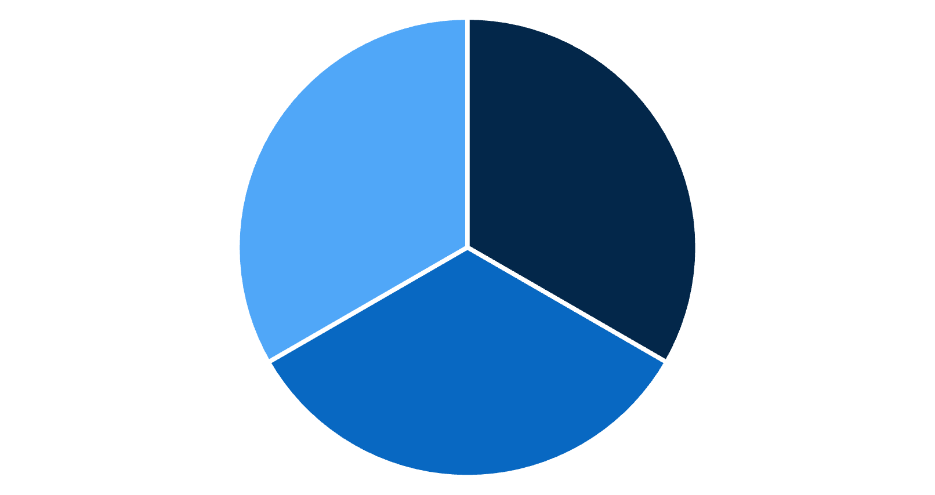
Iris Dataset: Structure and Composition
Dataset Overview
Features
Source: Iris_data.csv
Sepal Length: Length of the sepal (outer leaf-like structures) of the flower.
Dimensions: 150 rows, 5 columns
Class Balance
Sepal Width: Width of the sepal of the flower.
The dataset is perfectly balanced with 50 samples for each of the 3 species.
Petal Length: Length of the petal (inner, often colorful structures) of the flower.
Petal Width: Width of the petal of the flower.
Target Classes
Iris-setosa
Iris-setosa
Iris-versicolor
Iris-virginica
Iris-versicolor
Iris-virginica
3

Slide 4
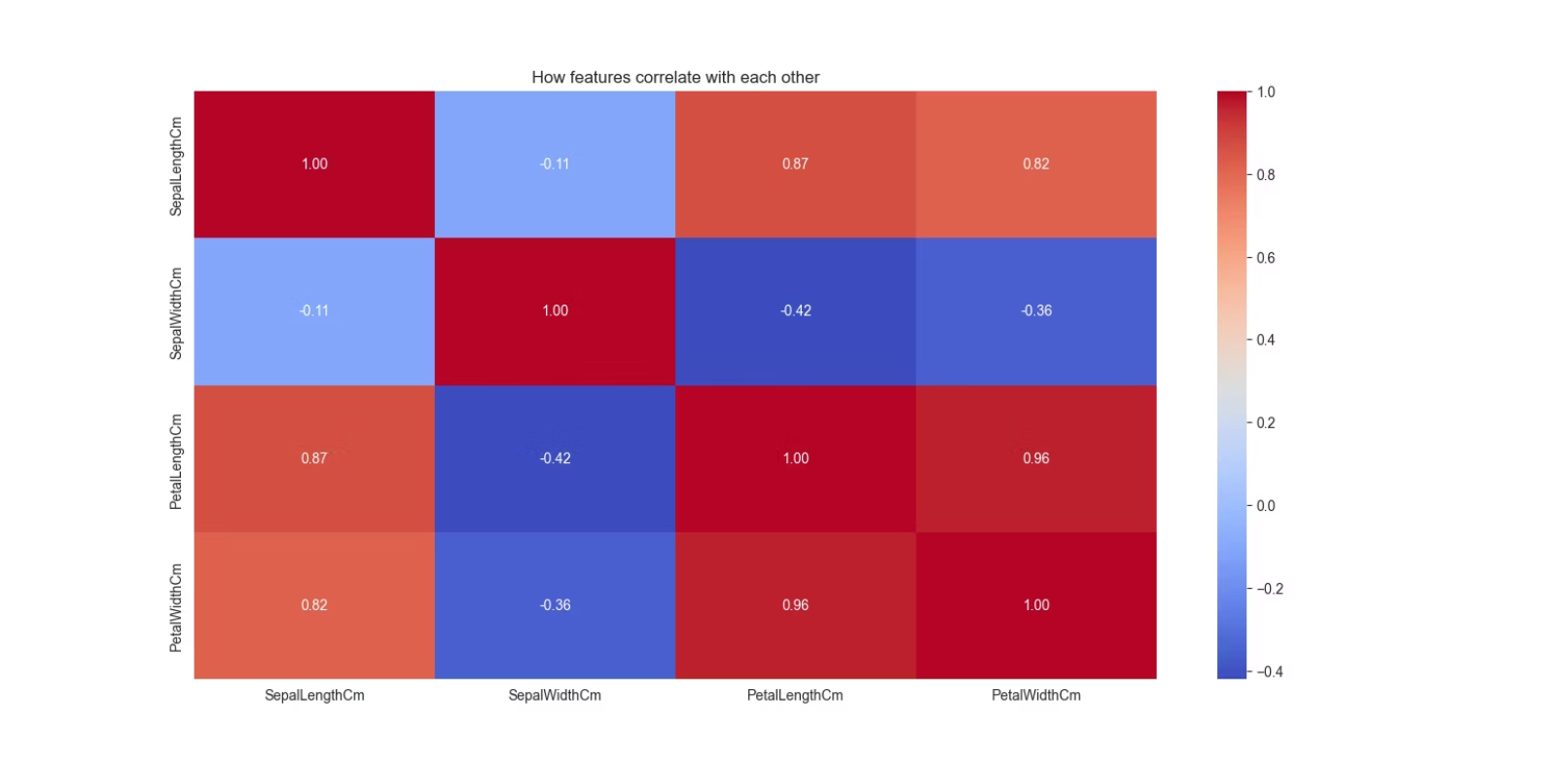
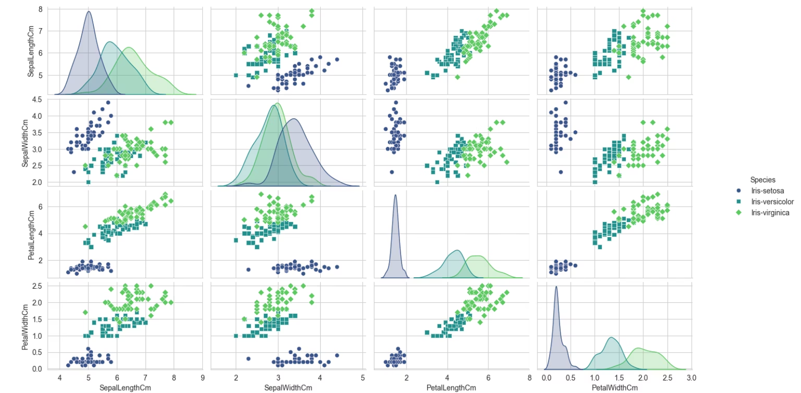
Exploratory Data Analysis: Feature Correlations and Relationships
This slide presents the actual EDA results from the Iris classification project. Two key visualizations are shown:
1. Correlation Heatmap
2. Pairplot
Shows how features correlate with each other. Darker red indicates stronger positive correlations. Key finding: Petal Length and Petal Width have the strongest correlation with the target species.
Displays relationships between all feature pairs. Shows that Iris-setosa (blue) is completely separate from the other two species. Versicolor (green) and Virginica (orange) have some overlap, making them harder to distinguish.
4

Slide 5
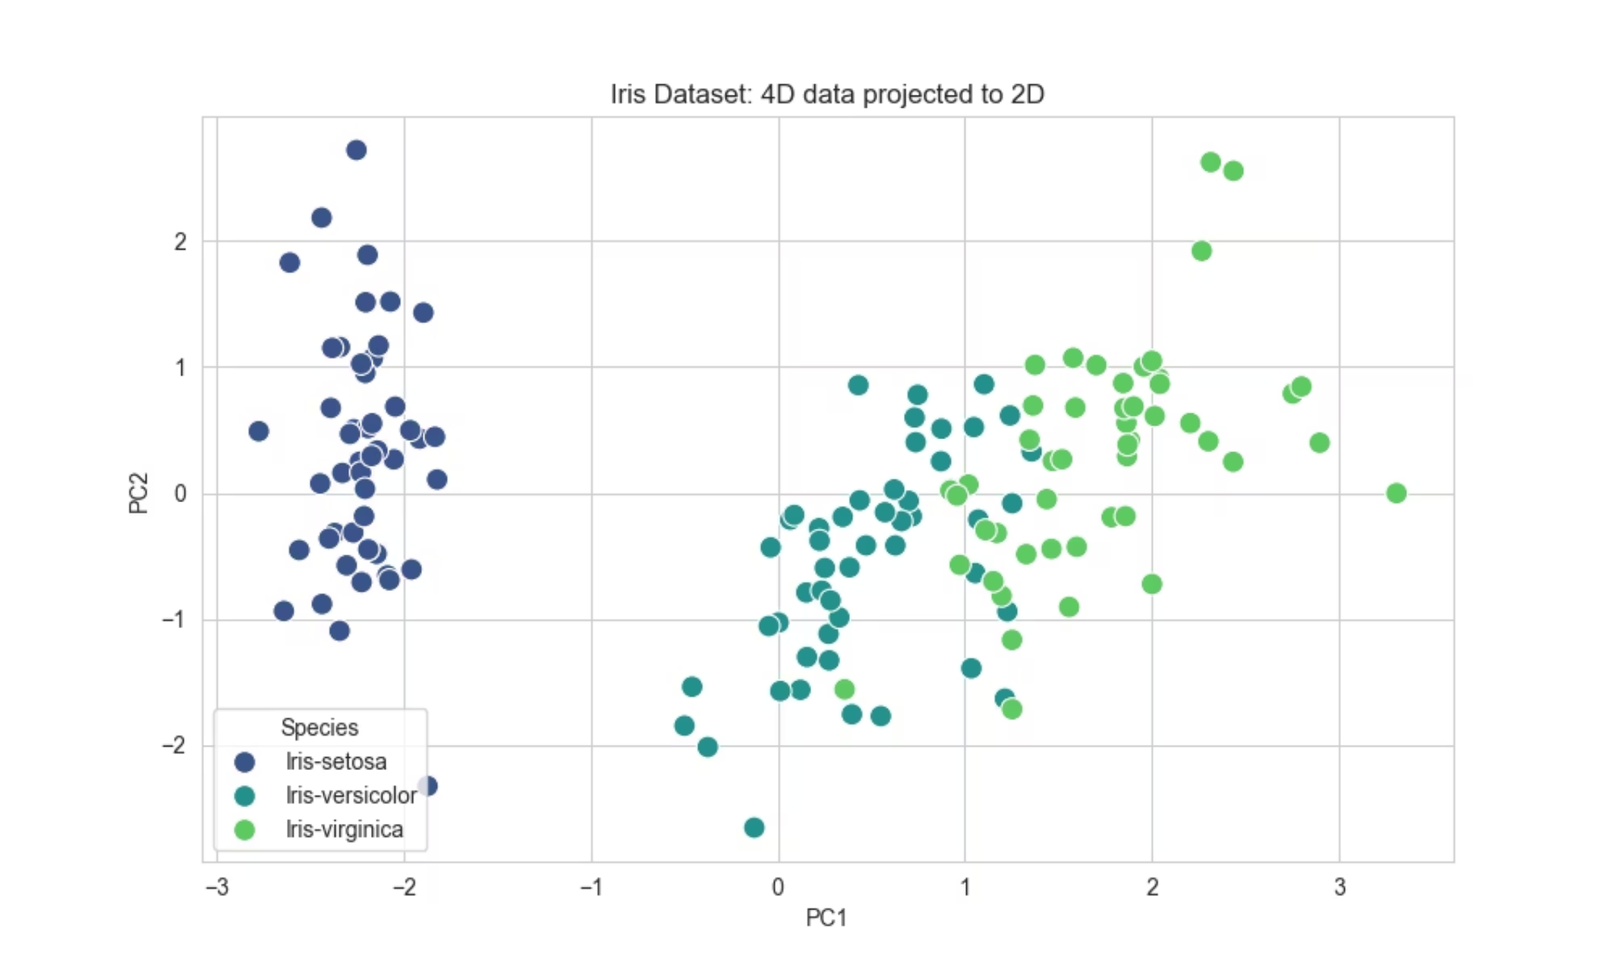
Dimensionality Reduction: From 4D to 2D with PCA
Principal Component Analysis (PCA) was applied to compress the 4-dimensional feature space into 2 dimensions for visualization.
Key Finding:
The first two principal components captured 95.80% of the total variance. This proves that the dataset contains redundant information and can be simplified without losing key patterns.
Visualization:
The 2D PCA plot clearly shows the three iris species separated in the reduced dimensional space. Iris-setosa (blue) forms a completely distinct cluster. Iris-versicolor (teal) and Iris-virginica (green) have some overlap but are largely separable.
Insight: The high variance retention (95.80%) indicates that the original 4D data has strong underlying structure that can be captured in just 2 dimensions. This makes the classification task feasible.
5

Slide 6




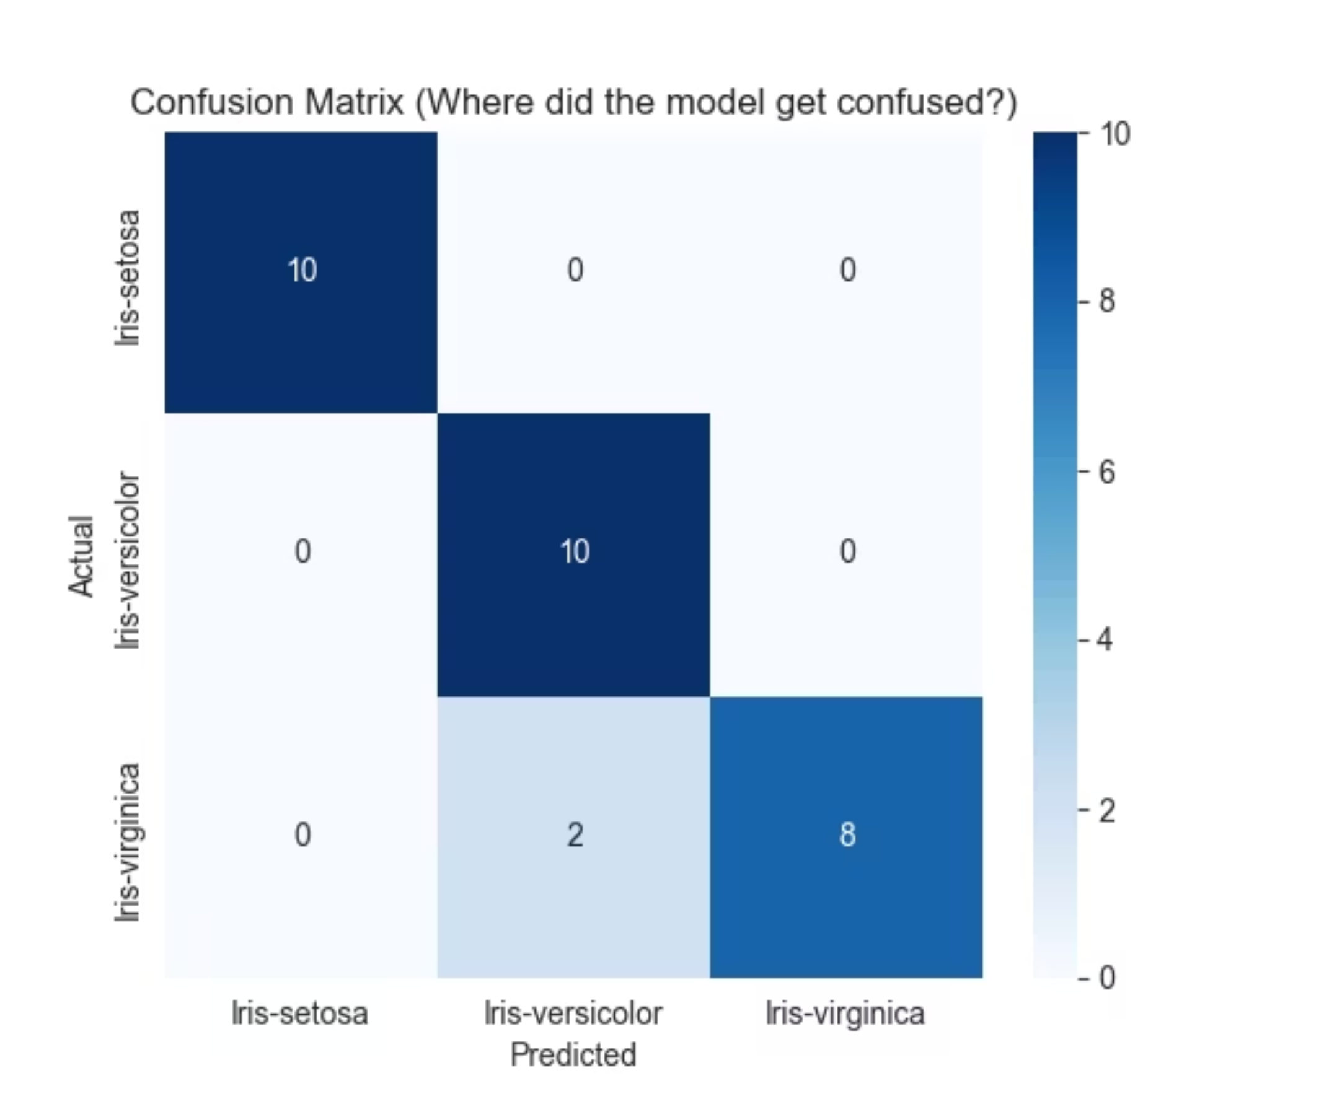
KNN Model: Training, Optimization, and Performance
Preprocessing
Algorithm
Applied StandardScaler to normalize features (Mean=0, Variance=1). This is critical for KNN because it relies on distance calculations.
K-Nearest Neighbors (KNN).
Hyperparameter Tuning
Optimal Parameter
Used GridSearchCV to test K values from 1 to 25.
The AI determined K=5 provided the best balance between bias and variance.
Performance
Test Accuracy: 93.33%. Confusion Matrix: The model successfully classified all Setosa samples. The few errors likely occurred between the overlapping Versicolor and Virginica classes.
s
6

Slide 7
Key Takeaways and Future Directions
1
2
Conclusion
Live Testing
The K-Nearest Neighbors algorithm (with K=5) is highly effective for this task. The PCA analysis confirmed that the species are mathematically distinguishable.
The system correctly identified a small flower as "Setosa" and a large flower as "Virginica" in the live test script.
3
4
Recommendations
Future Work
Deployment: The model is ready for deployment in a botanical app.
To reach 100% accuracy, we could explore Support Vector Machines (SVM) which are often better at handling the specific boundary overlap between Versicolor and Virginica.
Warning Fix: The user warnings seen in the output (UserWarning: X does not have valid feature names) indicate the prediction function passes a raw Numpy array. For production, this should be converted to a Pandas DataFrame to suppress warnings.
7

